Slide 1
A Timeless Classic
Software Engineering Project
Jared Rubio, John Cervantes, Keeton Fell, Hadi Fawad

Slide 2
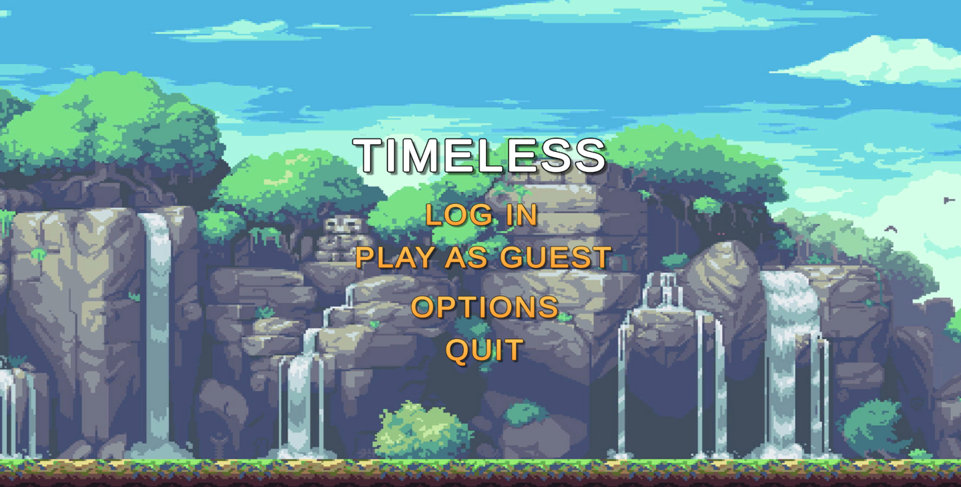
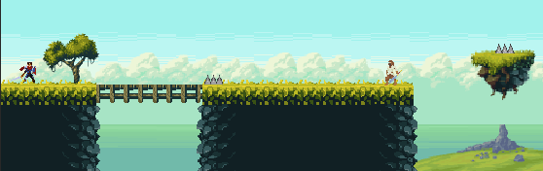
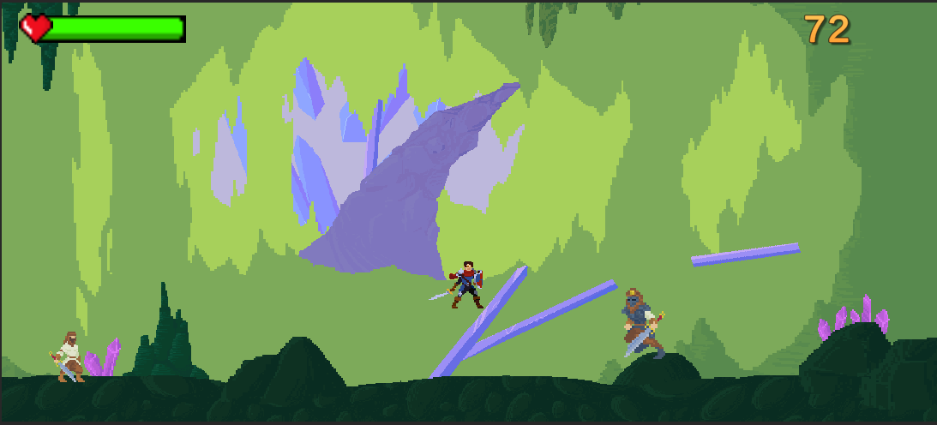
Our Project!
Timeless is a 2D Sidescroller Game set in a 8 Bit themed environment featuring multiple levels, various enemies, and additional features for functionality.

Slide 3
Software Functionality
Multiple Levels: Users can progress through different levels of difficulty and enjoy a range of challenges and obstacles.
Login and Authentication: Login functionality that allows users to log in and play the game with additional features
Guest User Access: Option for guest access, which allows users to play the game without logging in
In-Game Timer: Allows users to track how long they have been playing the game
Timer based Leaderboard: Allows users to see how their performance compares to other players and compete to get a spot at the top of the leaderboard
Volume Control: Our software system includes an options menu that allows users to adjust the volume of the game's music

Slide 4
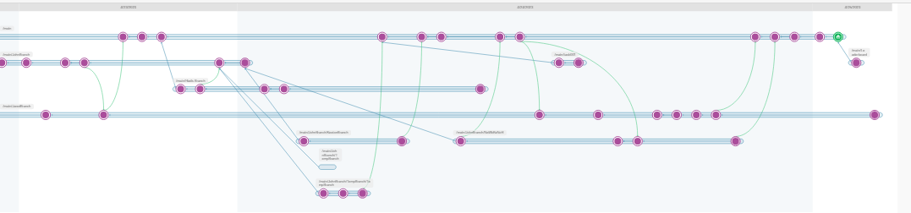

Version Control
For our project, we used Unity as our game development platform, which comes with a built-in version control system called Plastic SCM.
To create an organized system, we had each member create their own branches within Plastic and Commit their changes to their own branches, which would then be reviewed by another member of the team and pushed into the main branch as an official change.
There were multiple occasions where we would have to revert to a previous version of the code to address issues in: Level Design, Enemy AI, UI, Assets, & Scripts.
https://github.com/Hadi-Fawad/TimelessProject

Slide 5
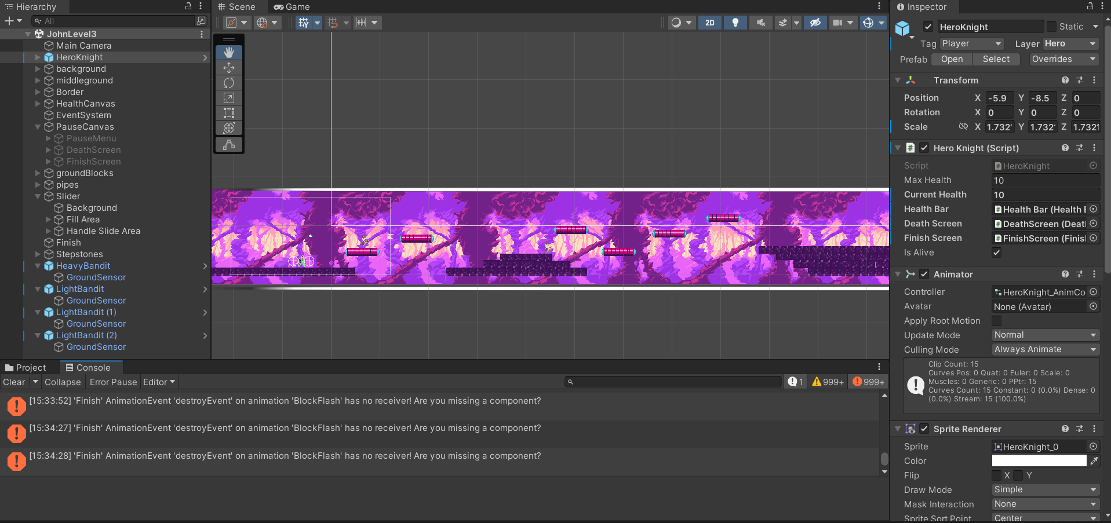
Testing Approach
Our approach to testing was primarily manual, using the Unity Editor to manually test all of our functions. We also ran the game and checked to see if certain tasks worked correctly.
In addition to manual testing, we used the Unity Debugger, a built-in tool that allowed us to identify and fix issues in our codebase, which can be considered a form of automated testing.While we did not use many automated testing tools or technologies, we were thorough in our testing efforts and ensured that all components and functionality of our software system were tested extensively.

Slide 6
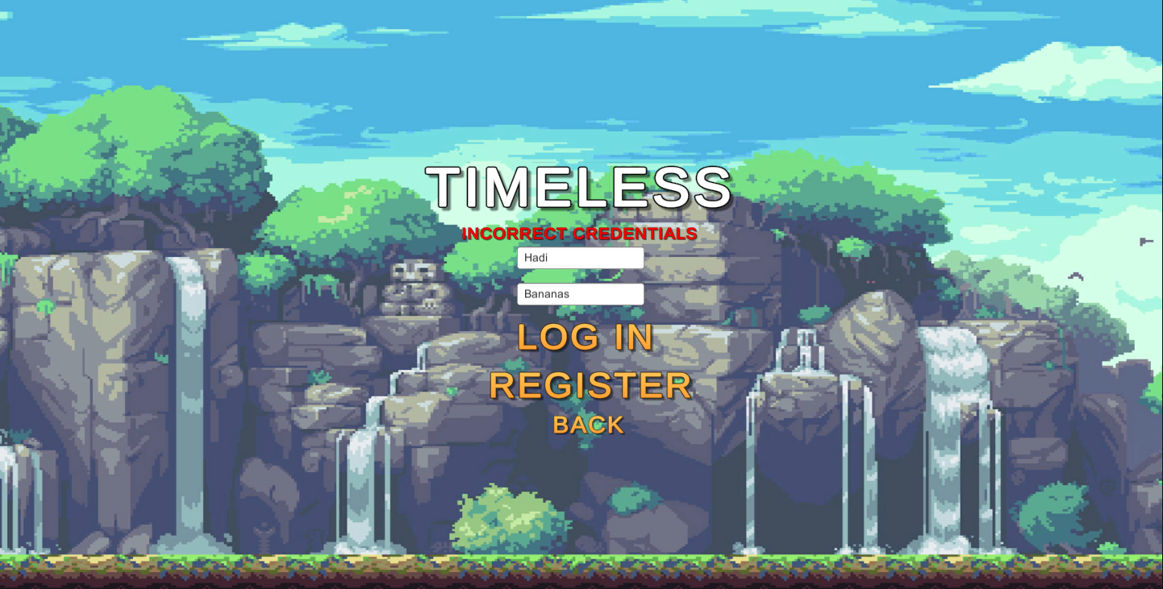
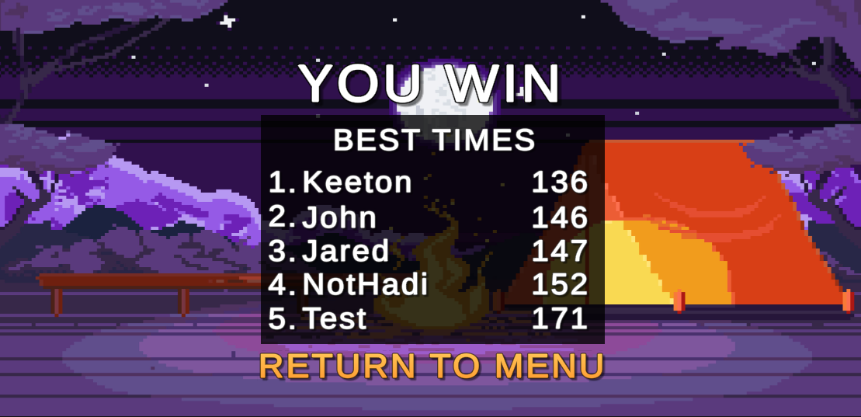
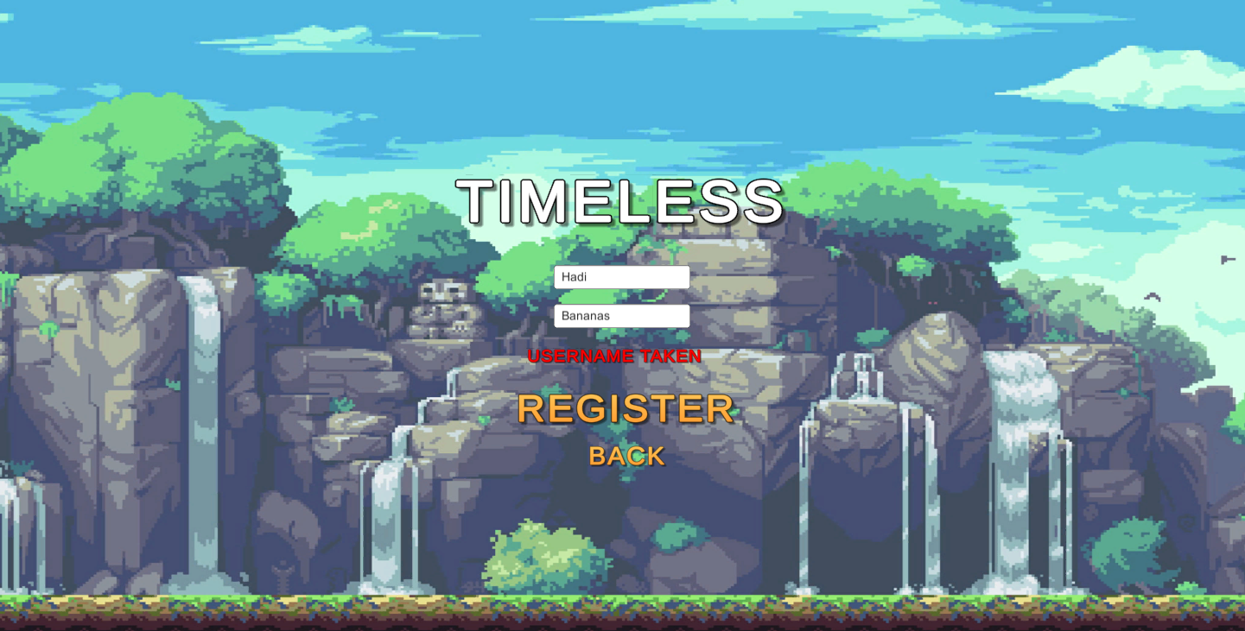
Persistent Data
All the Persistent Data is stored in a JSON file which is accessed by Unity. The persistent Data in our system is the User Login/Password and Leaderboard times.

Slide 7
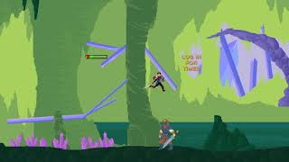
Demo
https://www.youtube.com/watch?v=Uh1iOnzBLss

